Slide 1

Niibish Aki Ojibwe for “Tea of the Earth”
Notes:
Imagine walking into a tea shop, looking at the menu, and realizing you’ve already tried the flavors being offered. You wonder what other potential flavors there are.
My capstone project <CLICK> Niibish Aki will do just that.

Slide 2
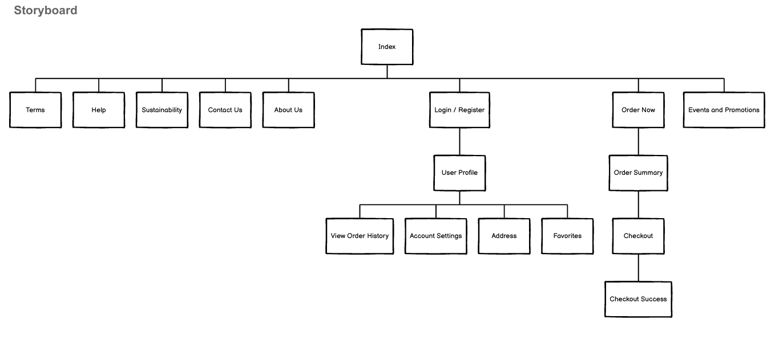
This storyboard will walk through the ordering process, from when the user enters the site through the index to the checkout success.

Slide 3
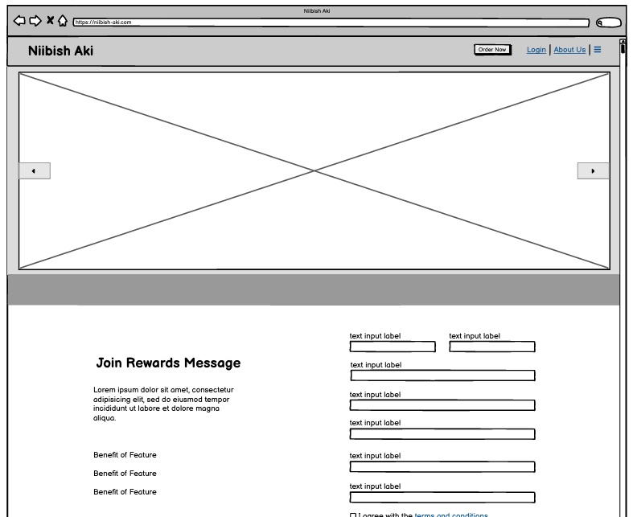
User loads the website in their preferred browser.
They click on “Order Now”.

Slide 4
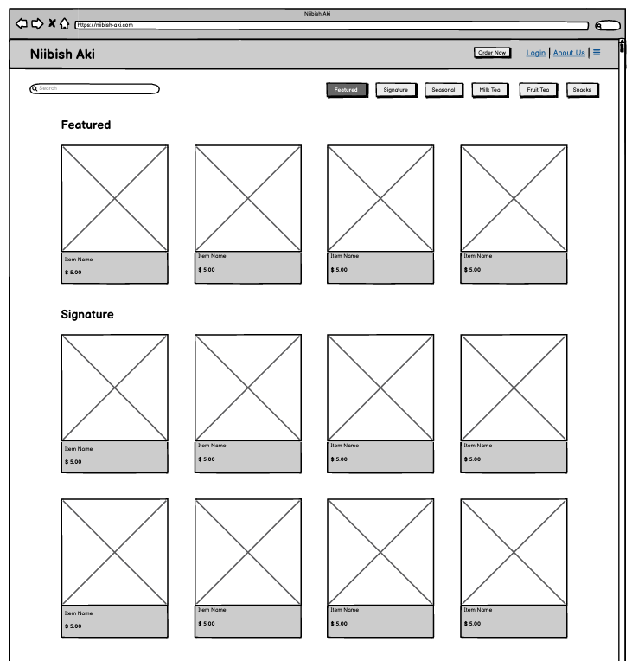
3. User finds a product that interests them.
4. They click on the product.

Slide 5
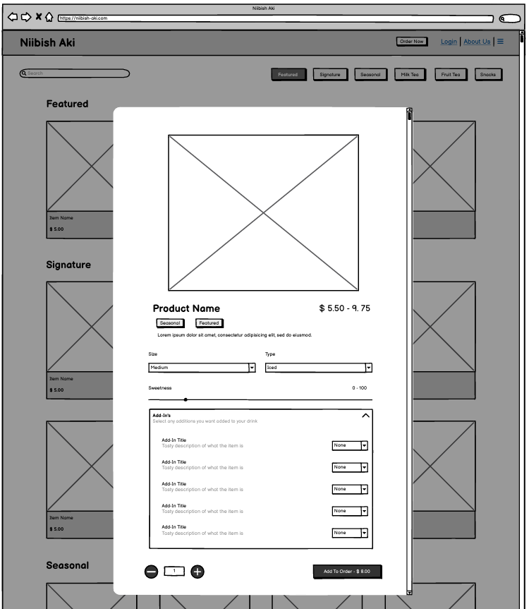
5. A modal appears for the user to customize their beverage.
6. They click on “Add to Order”.

Slide 6
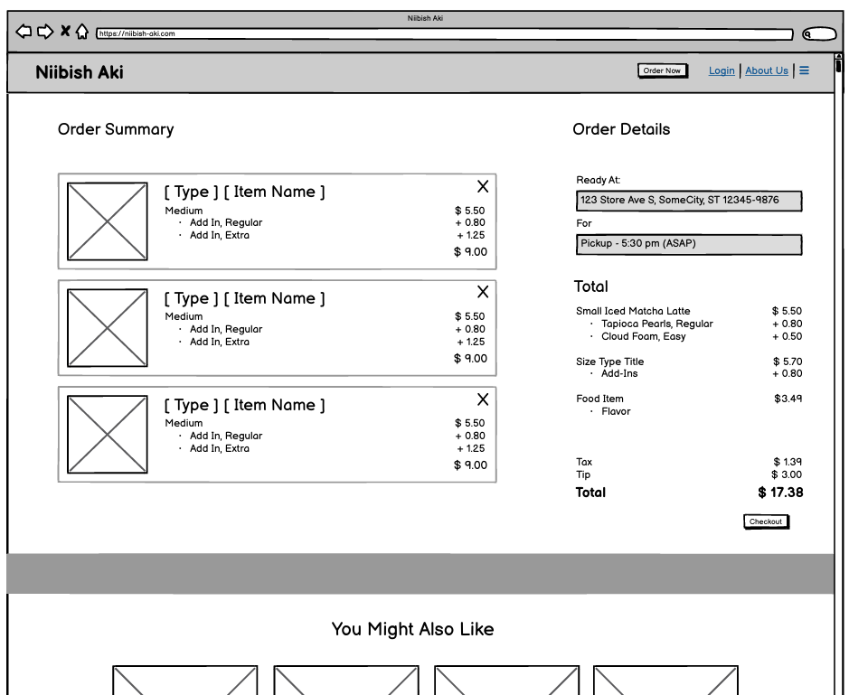
7. User reviews their cart.
8. They select their pickup time.
9. They click “Checkout” to proceed

Slide 7
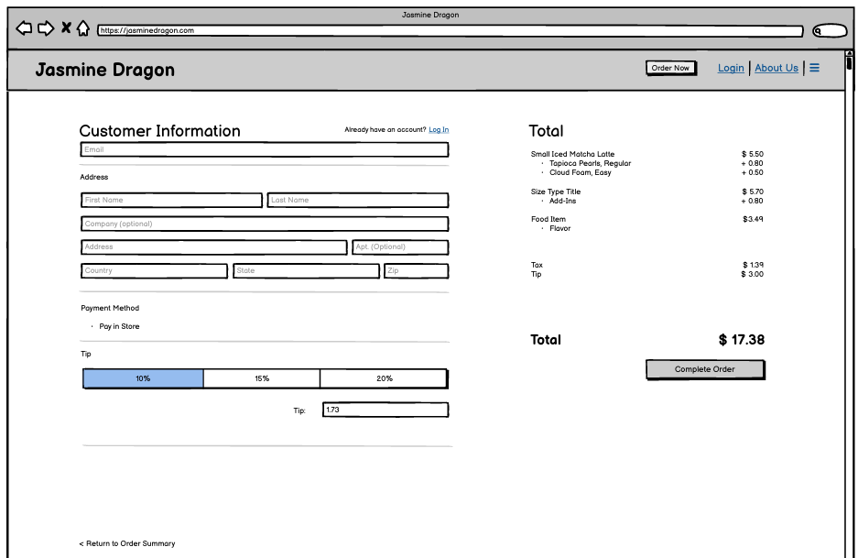
10. User fills in their information.
11. They select the tip
12. They click “Complete Order” to complete their order.

Slide 8
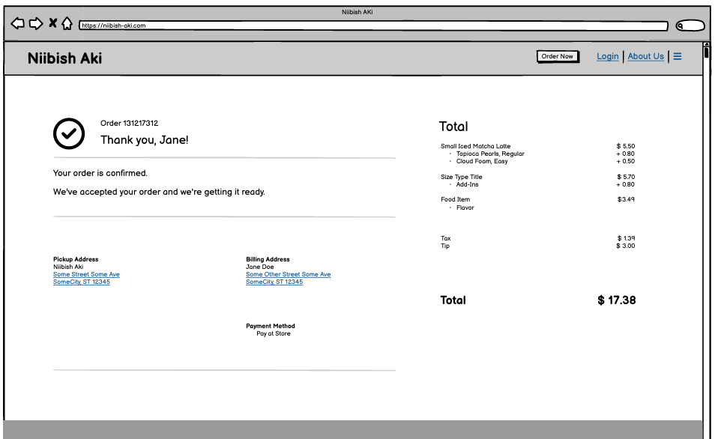
13. The order is complete. The user heads to the store for payment and pickup.

